Slide 1
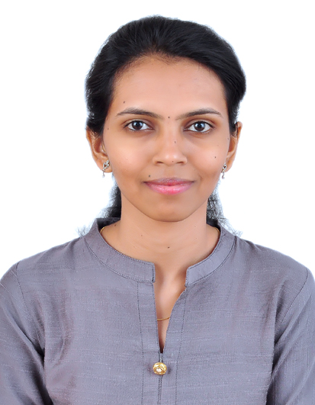

Komal Badhe
Email
Phone
Location
LinkedIn
:komal.badhe@zensar.com
: +91 9766914979
: Pune
: komal-badhe-a8b66310a
Personal & Professional details
Key projects & achievements
Role & experience
Trainee - Intern with 6 months of experience in software development with special interest in new technology, tools and frameworks.
Develpment and designing Of the application
Project : Automobile Associations
Project Specific training
Training and POC on Java And Micro-service
Training and POC on Angular
Training and POC on Spring Boot
Training and POC on AWS
Project : Asset Management System
Involved the requirement gathering, analysis,design and development of the application
Implemented server side programing using MVC pattern and REST Web services
Involved the bug fixing and performance tunning for back end code and database.
Database end responsiblity including creation of tables and join quiries
Education
MCA
2019
Bsc, Computer Sci
2015
Core competencies
Category | Skills | Exp (yrs) | Details
Vertical | UK and India | 6 Months | Worked with Indian Client
Domain | Insurance | 6 Months | AA,Lexicon Networks
Tools | Eclipse,Anypoint Studio Code,Postman,Maven,Git | 6 Months
Skills | Java,Angular,JSON,HTML, CSS,Javascript, SDLC,REST, Hibernat,Spring |  | Work in 1 team with 5 members
Certifications
Microsoft Certified Database Administration Fundamentals, 2018
Achievements
Employment History
Zensar Technologies, Jr. Software Engineer (Sept 2019 - Current)
Lexicon Networks India Pvt. Ltd. ,Trainee - Intern (Jan 2019-July 2019)

